Slide 1
So, you wanna give a tech talk? David Makogon, Microsoft
#revconf
@dmakogon
dmak.io

Slide 2

Imagine that Great Amazing Thing you just worked on, and OH WHAT A STORY YOU COULD TELL! It has bells, whistles, drama, intrigue. There's some crafty code and a rarely-used workaround that could Change The World As We Know It! It talks about a new framework! And you have jokes! And pictures! And and and...
And... you have a huge audience filling seats. Different backgrounds. Different primary spoken language. Different eyesight & hearing. Different coding skills. Different attention spans. HOW WILL YOU SURVIVE!?!?
Having given, and watched, a huge bunch* of talks worldwide, I've learned many things that help (and hurt) presentations. In this talk, I'll attempt to use the "things that help" to show you things that help AND things that hurt** in hopes that all of our future talks can help more and hurt less.
*Huge bunch : a ridiculously-high number that gets larger every time I tell the story ** These things don't really hurt. But they may make you cringe. Or sigh. Or gasp.

Slide 3
Real simple agenda
Speaking tips n tricks (really, that's it)
Primarily for tech talks
Sorta applies to all talks

Slide 4
Tech talk tips & tricks - topics
The intro
Eye charts
Code editors and shells
Human interaction
Dealing with problems
Pre-talk prep
During your talk
Ending a talk

Slide 5
The intro…

Slide 6
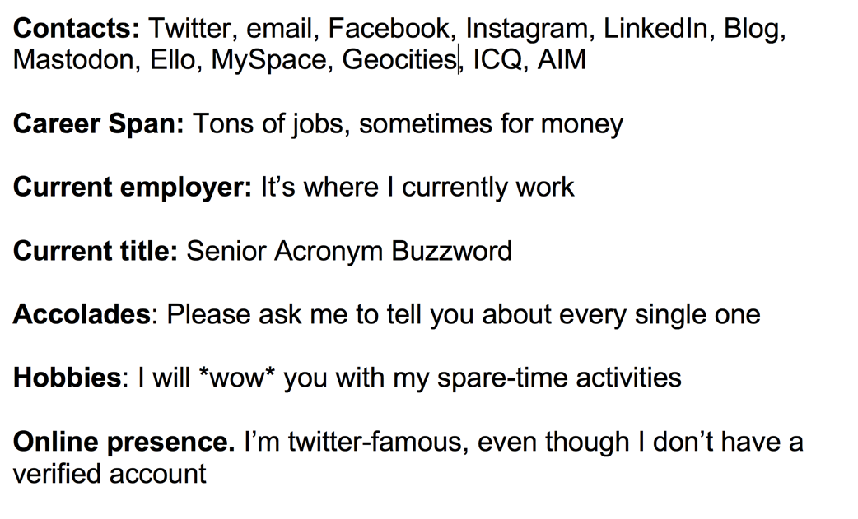
Your resume...
My title
My name, My company
My contact
...is not needed

Slide 7
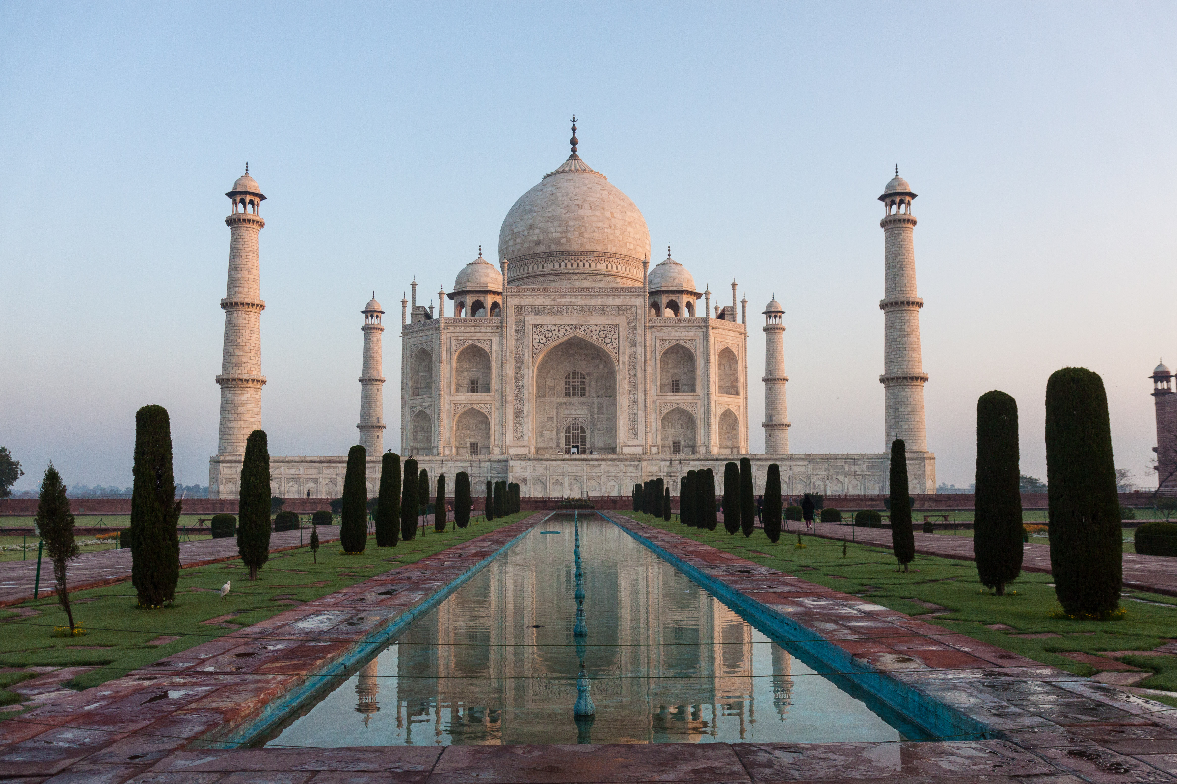

Who am I??? (hint: → David Makogon)
Azure architect
Camera carrier
Pun penner
NoSQL non-novice
Community congrat collector
- (World's first former) Azure MVP
- (Former) MongoDB Master
- Neo4j Ambassador
If there's one thing that's not clear to me, it's opaqueness.

Slide 8
Eye charts

Slide 9
Obligatory "bullet" eye-chart slide
Think about the content you're showing. Do you really need bullets at all? Does the little dot on the left help, or just look like annoying dots down the page?
Should bullets be shown all at once, or slow-rolled so that your audience can follow along?
Do you really need to write entire paragraphs to get your point across, or maybe you could just reduce to a few key words?
Can anyone even read what I posted up here? I mean, anyone in the back of the room???

Slide 10
Bullets (or not)
Bullets:
Yay?
Nay?
Make your point with few words, speak the rest

Slide 11
Code editors and shells…

Slide 12
Code eyecharts
view.on('init', function (next) {
var q = keystone.list('Post').paginate({
page: req.query.page || 1,
perPage: 10,
maxPages: 10,
filters: {
state: 'published',
},
})
.sort('-publishedDate')
.populate('author categories');
if (locals.data.category) {
q.where('categories').in([locals.data.category]);
}
q.exec(function (err, results) {
locals.data.posts = results;
next(err);
});
});
var q = keystone.list('Post').paginate({
page: req.query.page || 1,
perPage: 10,
maxPages: 10,
filters: {
state: 'published',
},
})
.sort('-publishedDate')
.populate('author categories');
Keystone.js – blog post listing
view.on('init', function (next) {
var q = keystone.list('Post').paginate({
page: req.query.page || 1,
perPage: 10,
maxPages: 10,
filters: {
state: 'published',
},
})
.sort('-publishedDate')
.populate('author categories');
if (locals.data.category) {
q.where('categories').in([locals.data.category]);
}
q.exec(function (err, results) {
locals.data.posts = results;
next(err);
});
});

Slide 13
Human interaction

Slide 14
Know your audience
Set expectation up front
Skill level and background – ask if unsure
Primary language (in general)
Assignment: look around you
Notes:
Advanced topic with beginners? Language barrier? Diversity!

Slide 15
Jokes
Political
There are 10 types of people:
Those who understand binary… And those who don’t
Off-color
Adult
Country-specific

Slide 16
Your voice
The volume
The direction
The mic
Notes:
Mic: learn to turn off (drinking, coughing)
Don’t face the screen when talking
Project your voice if no mic.
Always use mic! Clip-on is best
Remember the back of the room

Slide 17
Your location
Where are you hiding???
Are you moving?
Your laptop: Podium or table?
Beware small or tilted surfaces

Slide 18
Highlighting
Pointing devices
Hand gestures
Zooming
"As you can see…"
"You simply..."

Slide 19
Terms and acronyms
Don’t assume people know them.
You know them. Explain them.

Slide 20
Q&A – what to do
Look for raised hands
Repeat questions
Save to the end?
Interactive?
None?
It’s ok to cut short
(politely)
“I don’t know” is ok

Slide 21
Dealing with problems

Slide 22
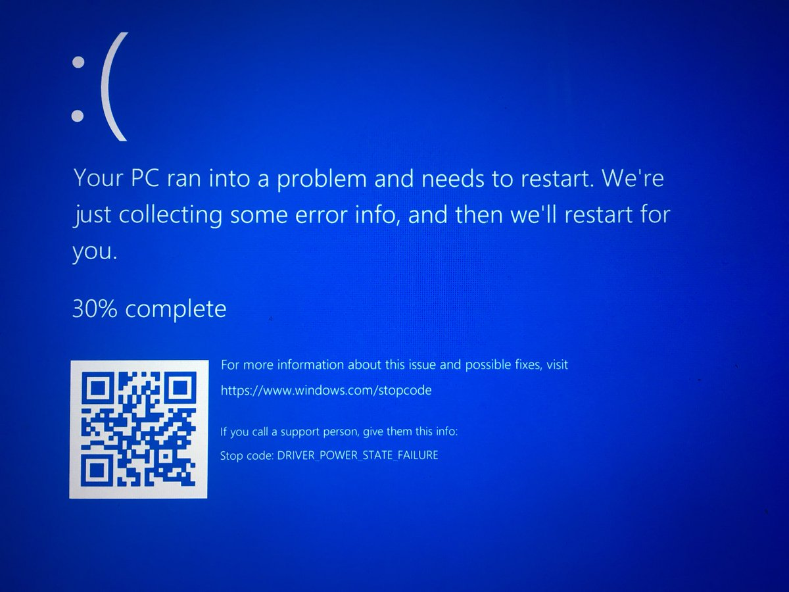

Slide 23
Dealing with problems
Computer crash
Network failure
Mouse failure
Clicker failure
Mic failure
Demo failure
Dead air
Projector failure
Power failure
Meltdown

Slide 24
Computer crash
Assume complete failure
Second computer?
Borrow computer?
Whiteboard?
Just… speak?
Notes:
Borrow / second computer: careful. Needs same tools, same presentation app

Slide 25
Network failure
Slow / dead wifi
Locked down ports
If you must have connectivity:
Consider a hot-spot
Maybe hard-wired ethernet?

Slide 26
Network failure
Most demos can be run locally (cloud might be tricky)
Local emulators
Local databases
Local web/app servers
Recorded demos

Slide 27
Demo failure
Won’t compile? Throws errors?
Live-coding is risky. Awesome, but risky.
Snippets
Backup (or-primary) project, done, pre-tested
Screen recording of live-coding

Slide 28
Dead air
Some things take a while
Some things require typing
Narrate
Talk through things

Slide 29
Meltdown
Talks are fun! But… Sometimes nerves win.
Totally ok to be nervous!
Take a moment, if you need it
Stay comfortable – maybe sit, hide a bit?
Maybe insert a story?

Slide 30
Organizing your talk

Slide 31
Content to consider
Drawings
Code libraries
Github repos
Code
Running demos
Data-viewing
Debugging

Slide 32
Non-tech content to consider
Title slide with simple contact info
Intro slide
Topic and summary slides
Closing slide with contact info + links

Slide 33
Where do code & demo go?
Slides
Videos
Editors
Command shells
Web

Slide 34
Bouncing between apps
For my talk today:
PowerPoint
VSCode
Command prompt
Browser

Slide 35
Bouncing between apps
Try to minimize switching
Don’t make people watch you alt-tab constantly
Keep minimal apps / tabs open

Slide 36
Pre-talk prep

Slide 37
Rehearsing and timing
New talk? New to talks? Rehearse. A LOT.
Old talk? Veteran speaker? Rehearse. Just do it.
Clock time: don’t use it all.
Q&A
Unforeseen problems
Delays in schedule

Slide 38
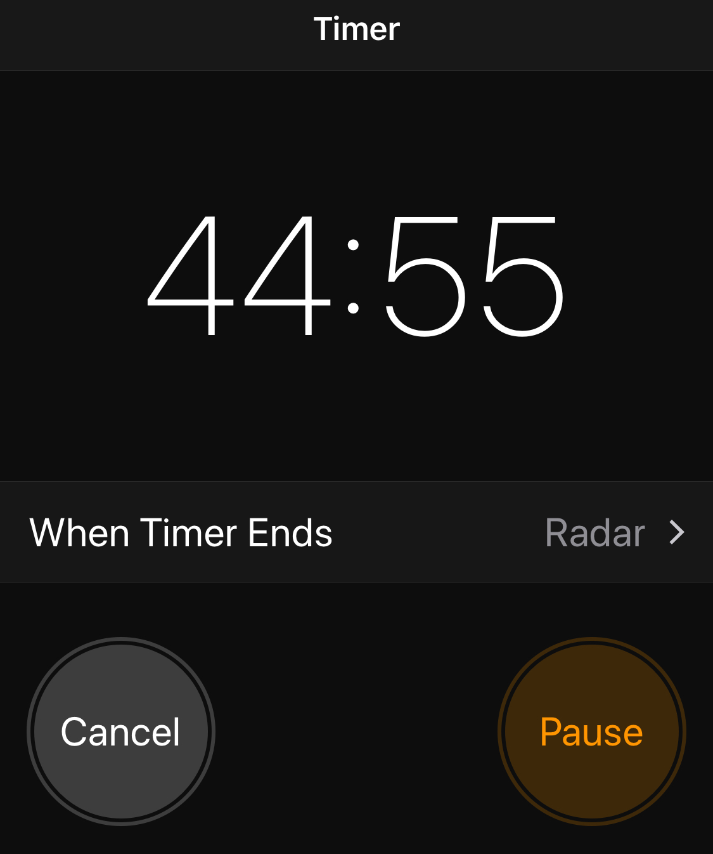
Where is a clock?
Countdown timers are great!
Consider checkpoints
It’s ok to skip stuff – don't rush through content
Avoid tangents

Slide 39
Checklist - hardware
Charged laptop(s) + Power adapters
Video + network adapters
Hotspot
Clicker / pointer / mouse
Device batteries (charged, plus extras)

Slide 40
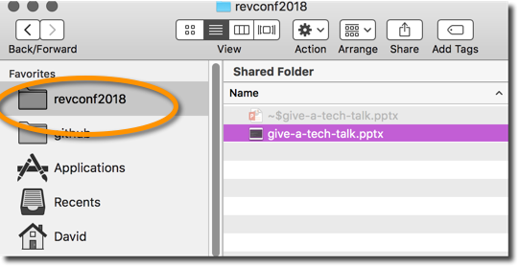
Checklist – OS and software
Apps installed
Code downloaded / cloned
Directory-jump quick-links
Start & test utilities you need (e.g. ZoomIt)
Cloud? Test non-standard ports
Timezone: system clock

Slide 41
Checklist – non-essentials
Shut down email / chat
Shut unneeded browser tabs
Turn on presentation mode
Turn off:
screen savers
notifications
sleep
backup software
phone ringer

Slide 42
Checklist – personal
Clothing
Water/soda available
Stress toys / spinners
Props?
Hide your personal stuff
Are you ok with being recorded?

Slide 43
Checklist – before presenting
Arrive early
Extended Screen / resolution test (slides, code, text)
Mic test
Network test
Notes available
Bathroom break
Notes:
Mac and PC behave differently, with duplicating vs extending screens Extended screens – complex to move mouse around

Slide 44
During your talk

Slide 45
Legs and eyes
Are you moving at all?
Where are you looking? Who are you looking at?
Notes:
Mac and PC behave differently, with duplicating vs extending screens Extended screens – complex to move mouse around

Slide 46
Interruptions
Questions during? After?
Notes:
Mac and PC behave differently, with duplicating vs extending screens Extended screens – complex to move mouse around

Slide 47
Ending a talk

Slide 48
As time winds down…
Watch the clock
Watch for people holding signs
Questions at the end? Leave ~10 minutes
Interactive Q&A? Leave ~5 minutes

Slide 49
When time is up
This is the “you are done” moment
Thank the audience
Offer a slide with materials links
Pack up, even as people mob you
Avoid "content rush"

Slide 50
When time is up – why stop on time?
Next speaker needs to set up
wifi, projector, mic...
Audience gets antsy
"Should I stay or should I go..."
Audience has other plans
Snacks
Restroom
Seating in another talk

Slide 51
War stories

Slide 52
Real life “woes”
Power outage
Projector fail
Laptop crash
Notes:
Mac and PC behave differently, with duplicating vs extending screens Extended screens – complex to move mouse around

Slide 53
Wrap-up

Slide 54
Summary
The intro
Avoiding eye charts
Code editors and shells
Human interaction
Dealing with problems
Pre-talk prep

Slide 55
Questions?
Keep in touch!
Twitter: @dmakogon
Blog: dmak.io
Talk stuff at github.com/dmakogon/revconf2018

